Slide 1
ONLINE RESTAURANT Management system
Here our presentation begins
Presented by:
Maaz Habib
[20pwcse1952]
Hamid Ur Rehman [20PWCSE1969]

Slide 2
Table of contents
01.
Introduction
02.
E-R Diagram
03.
Web interface

Slide 3
Introduction
Different type of orders.
Categories
Viewing short and long description for ordering easily.
Online Meal

Slide 4
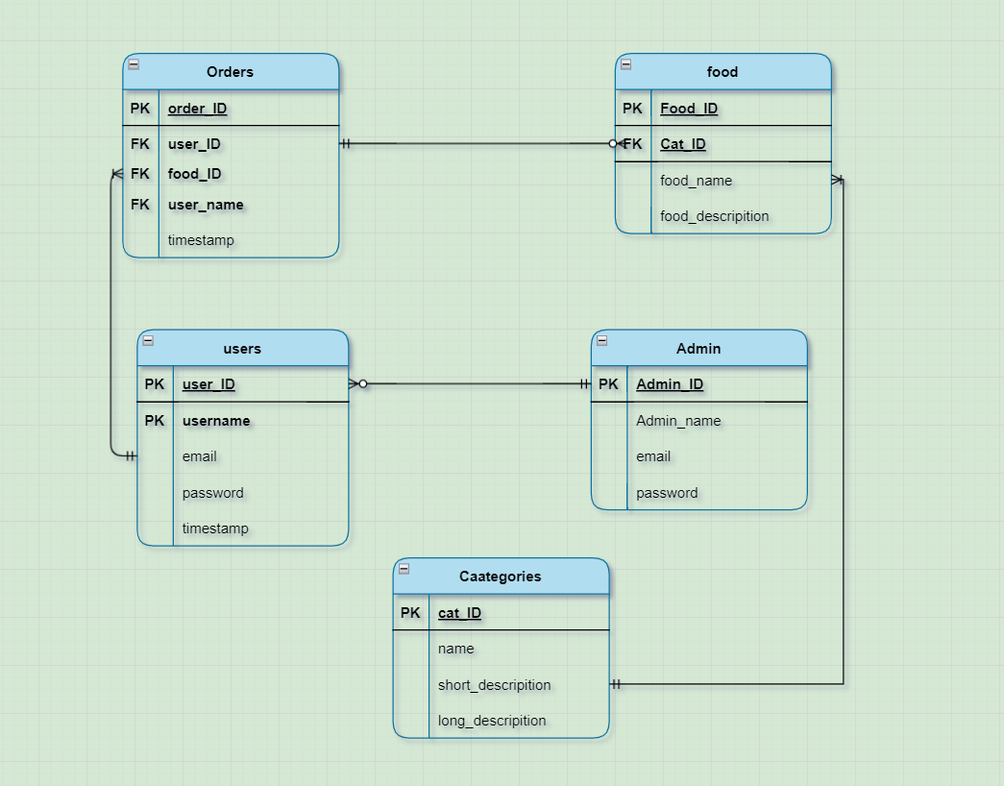
E-R Diagram

Slide 5
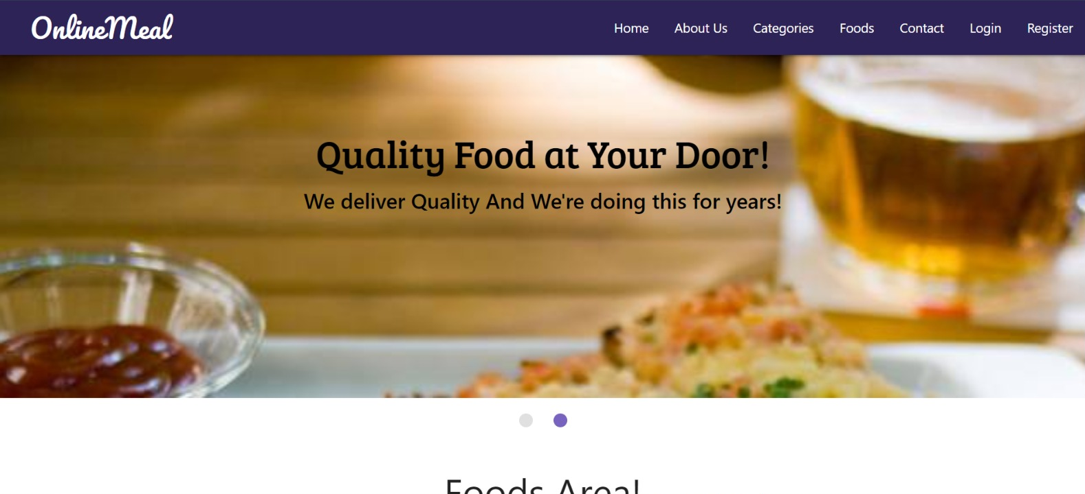
Web interface

Slide 6
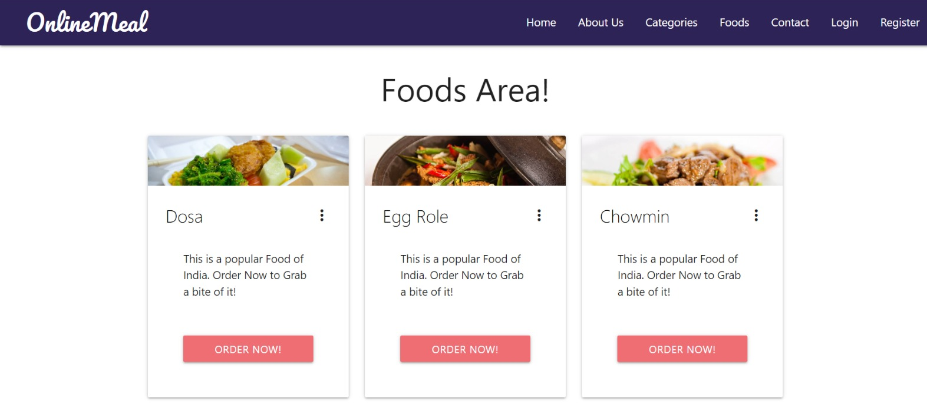
Categories

Slide 7
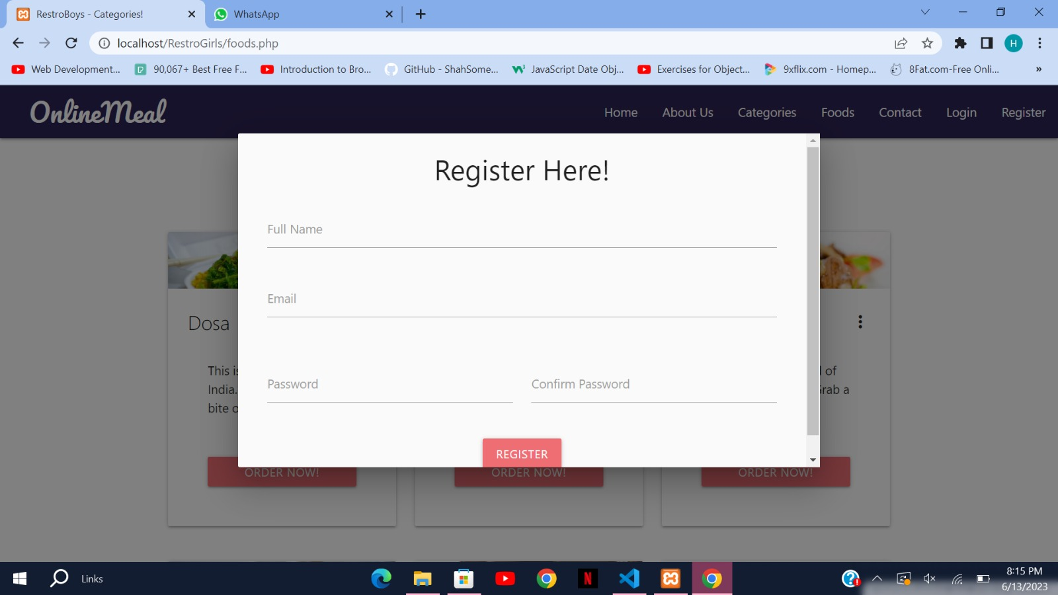
Sign up

Slide 8
Thank you!

